Slide 1
Facing the traps of decolonial critiques and opening up for other ways of existing inside/outside/beyond academia
Center for Global Higher Education Conference
April 4th, 2025
Notes:
Rox

Slide 2
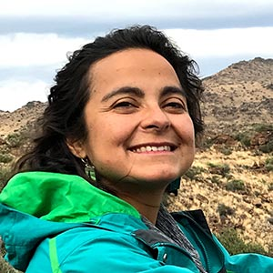
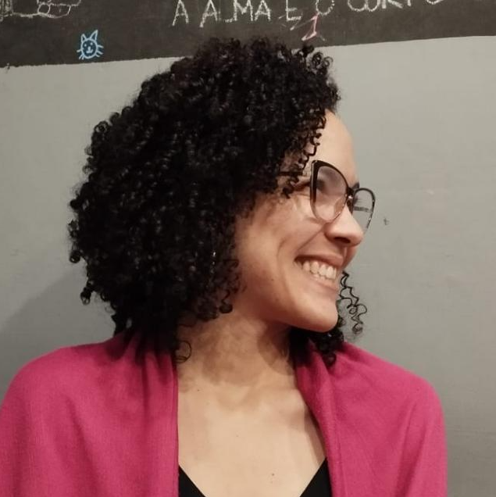
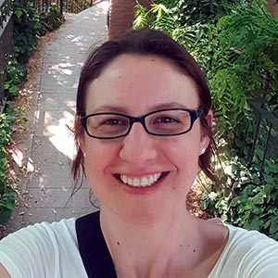
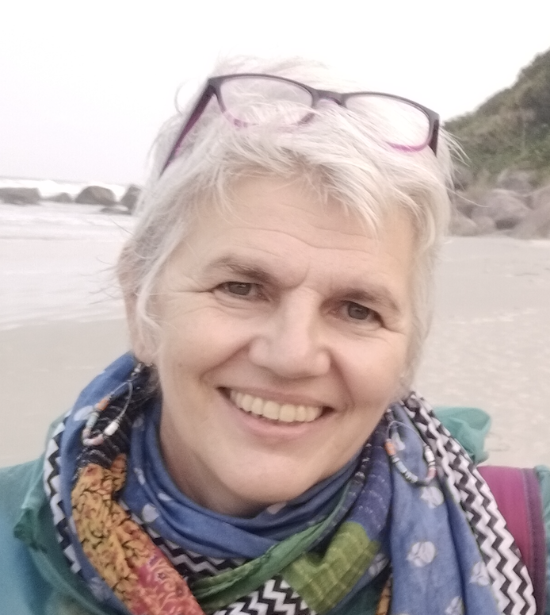
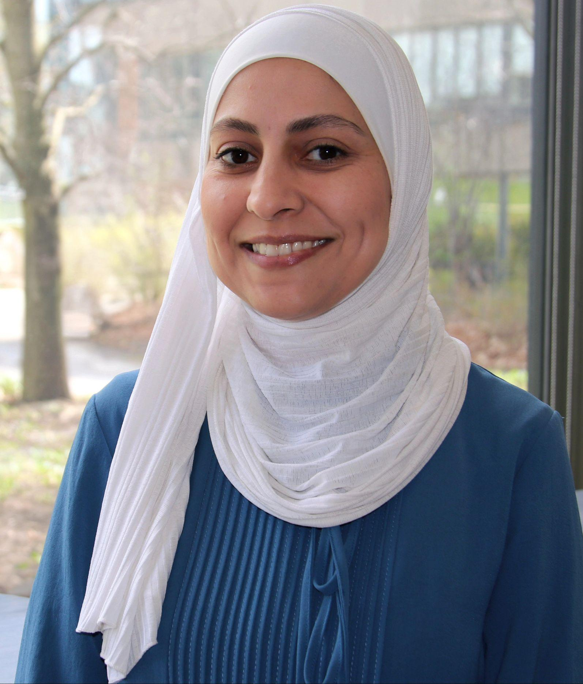
Roxana Chiappa
Jhuliane da Silva
Juliana Martinez
Hiba Ibrahim
Francesca Helm
Francesca Dell’Olio
Notes:
Rox

Slide 3
01
What do we mean by decolonial work and how are we connected to it?
Notes:
Ju

Slide 4
Abya Yala
Notes:
Ju

Slide 5
02
Why are we engaging with the idea of trampas (traps)?
What do we mean?
Notes:
Jhu + Rox

Slide 6
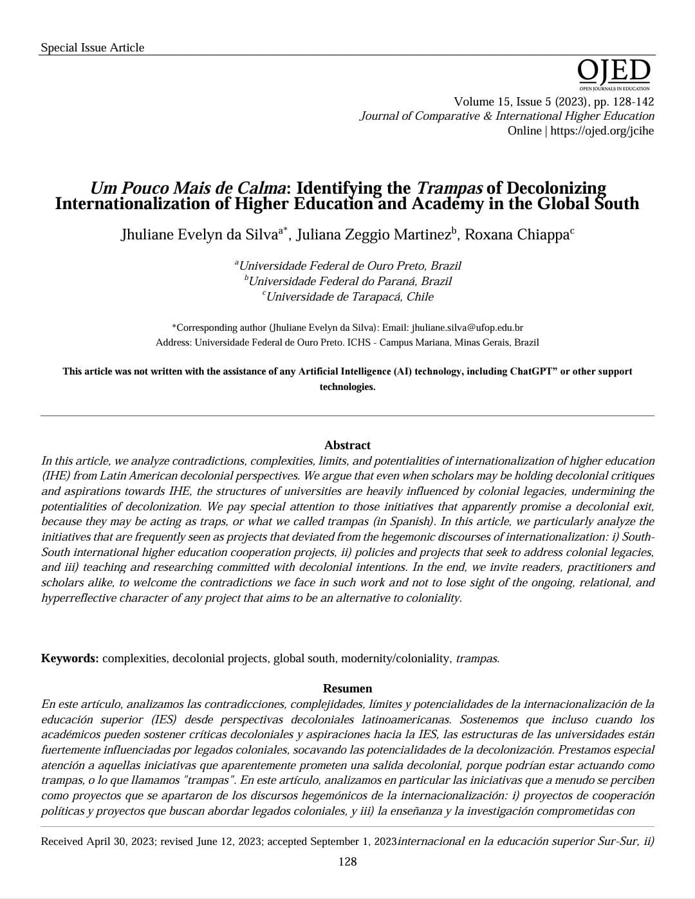
The trampas
#1 South-South IHE projects
#2 Policies and projects that intentionally seek to address and question colonial legacies
#3 Teaching and researching committed to decolonial intentions
Notes:
Jhu+ Rox

Slide 7
03
An invitation
Notes:
Rox

Slide 8
Some questions
How do we understand decolonial work in our context?
What are the projects with which we are engaging that go beyond the critique of coloniality inside and outside of academia?
How do we see ourselves going beyond those traps?

Slide 9
04
And you?
Broadening the dialogue

Slide 10
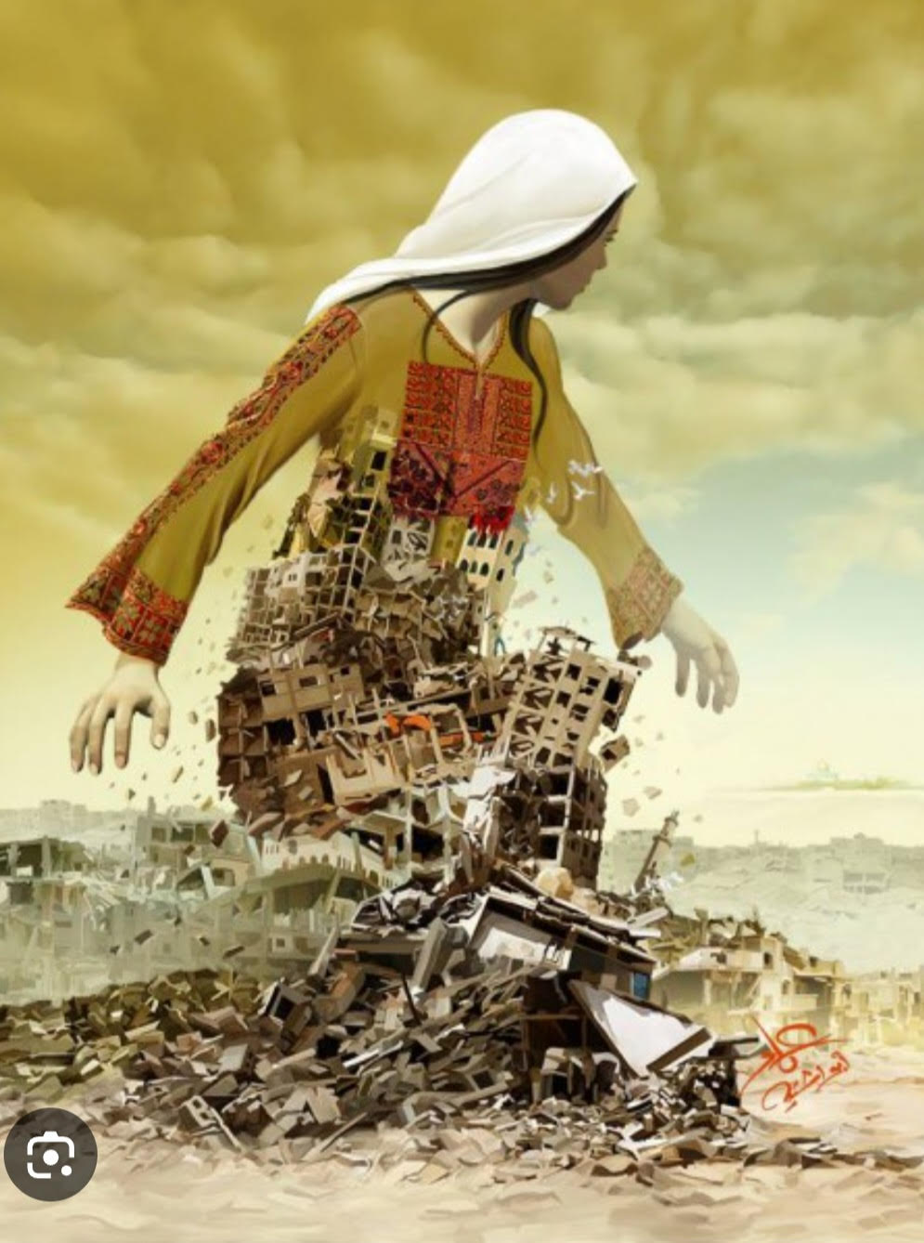

Slide 11
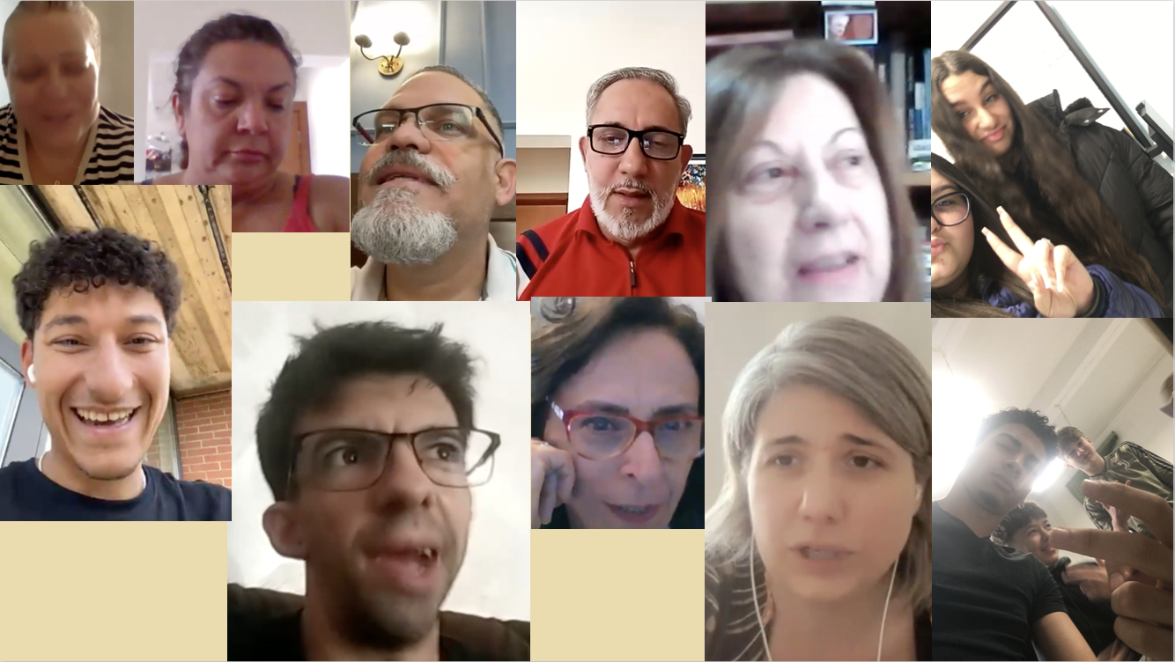

Slide 12
شكرًا
Obrigada!
Grazie
Gracias
Thank you

Slide 13
Bitte lösche diese Folie nicht, es sei denn du bist ein Premium Nutzer
Notes:
Slide design by Diese Präsentation Vorlage wurde von Slidesgo erstellt, inklusive Icons von Flaticon und Infografiken & Bilder von Freepik
Bitte lösche diese Folie nicht, es sei denn du bist ein Premium Nutzer

